Slide 1
Hierarchies

Slide 2
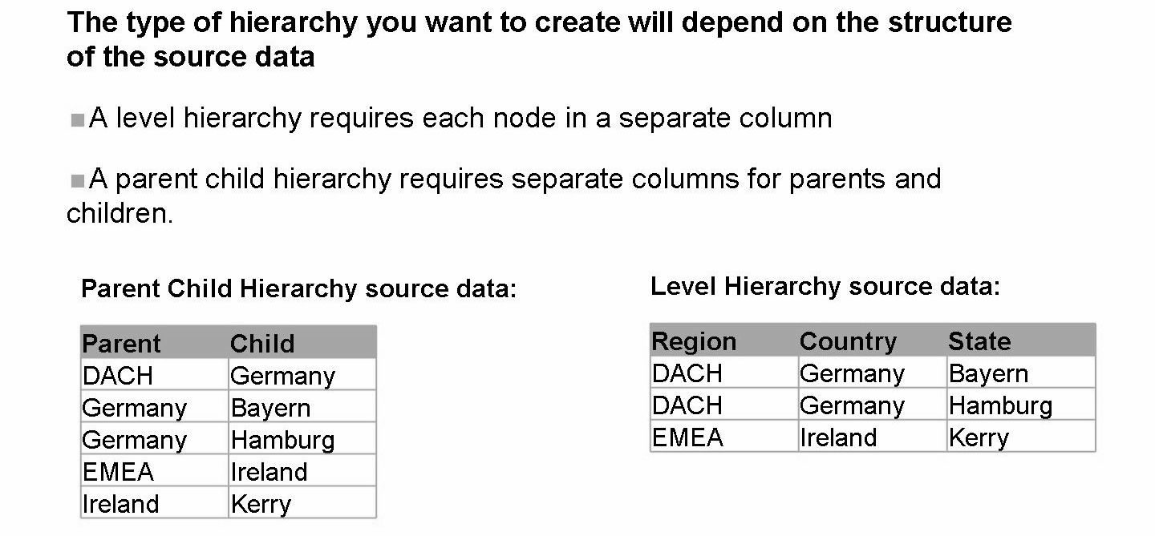
Using Hierarchies
Hierarchies are usually used in Business Intelligence reporting to display characteristics across aggregated nodes.
Two Types
1. Level Hierarchy 2. Parent Child Hierarchy

Slide 3
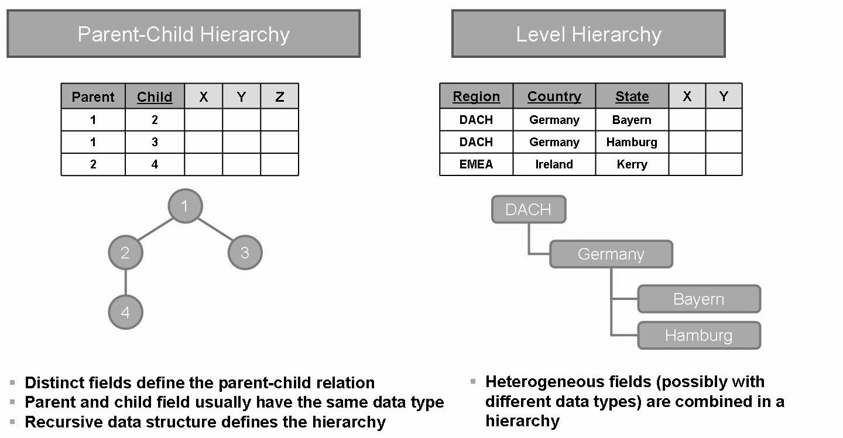
Hierarchy comparison

Slide 4
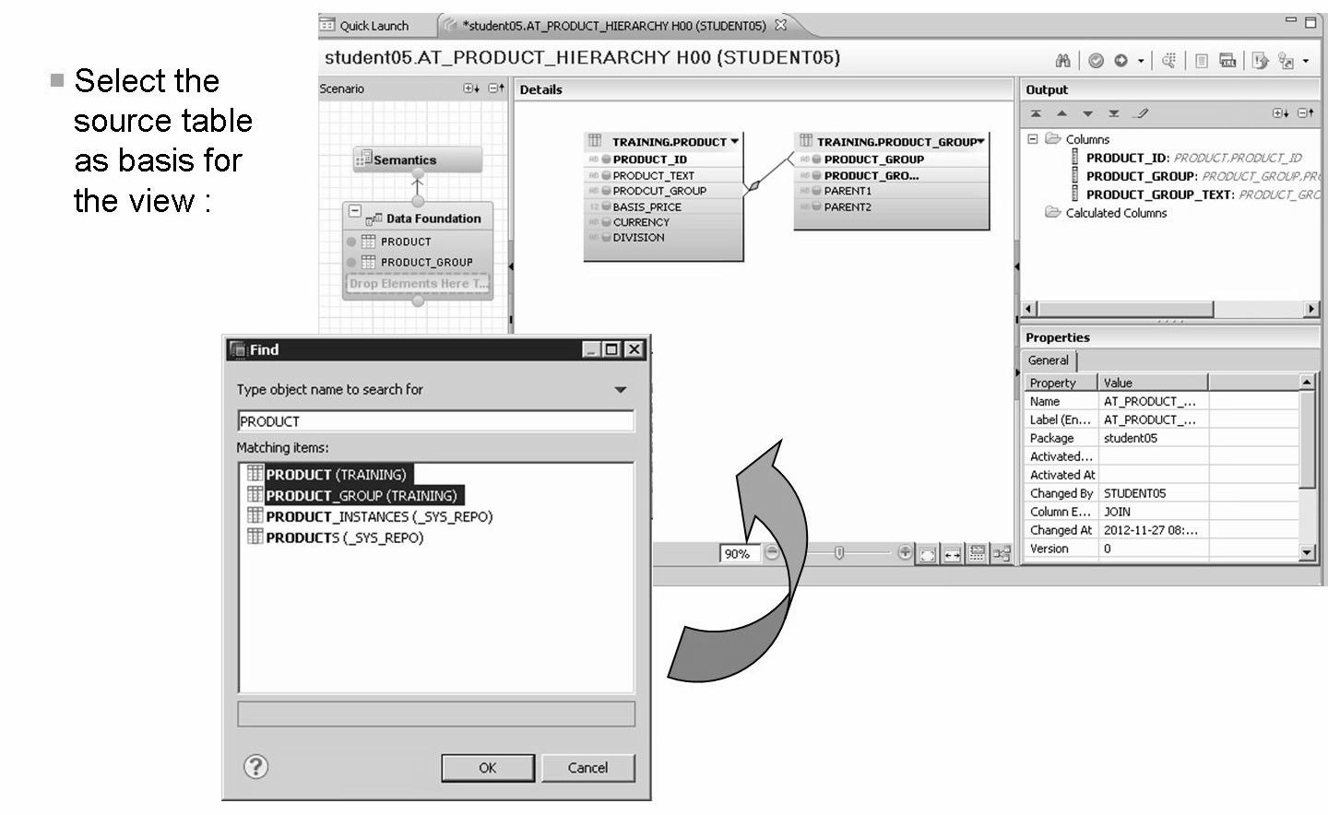
Implement Level Hierarchies

Slide 5
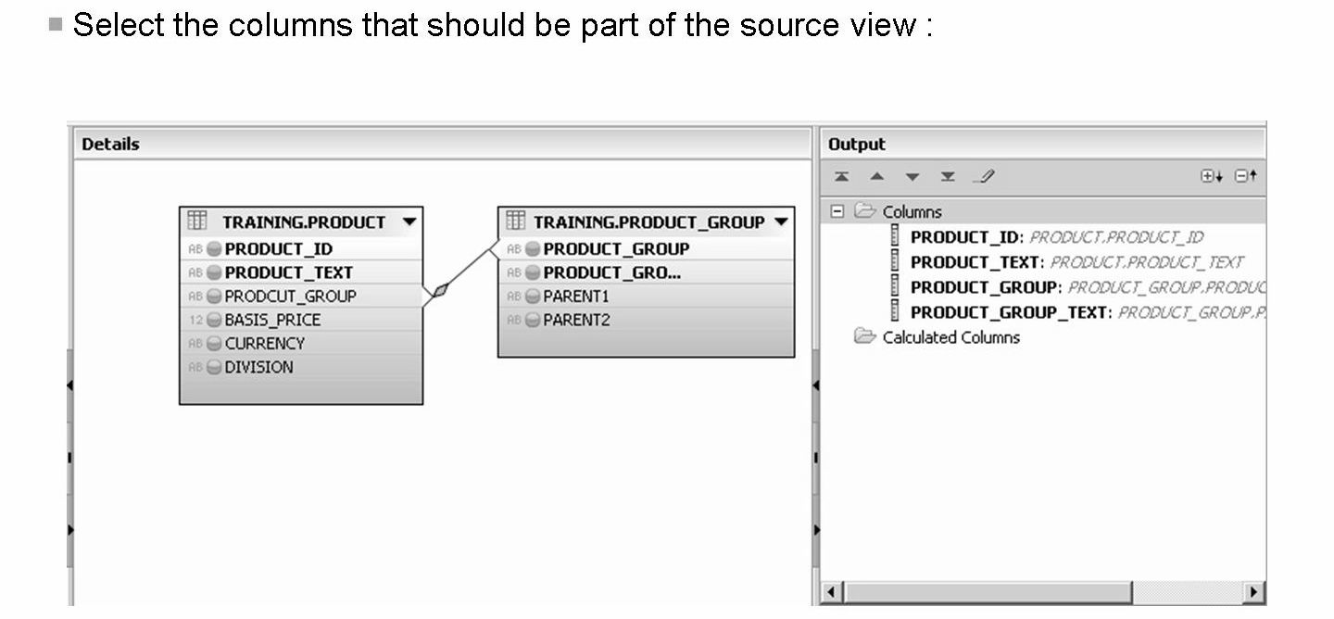
Select Columns

Slide 6
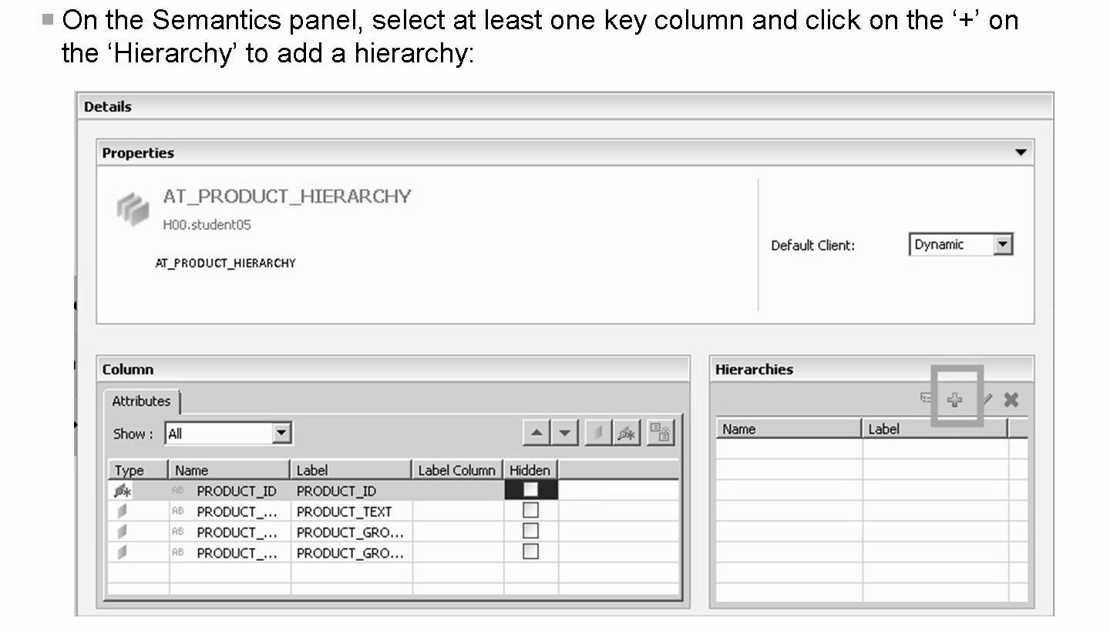
Add Hierarchy

Slide 7
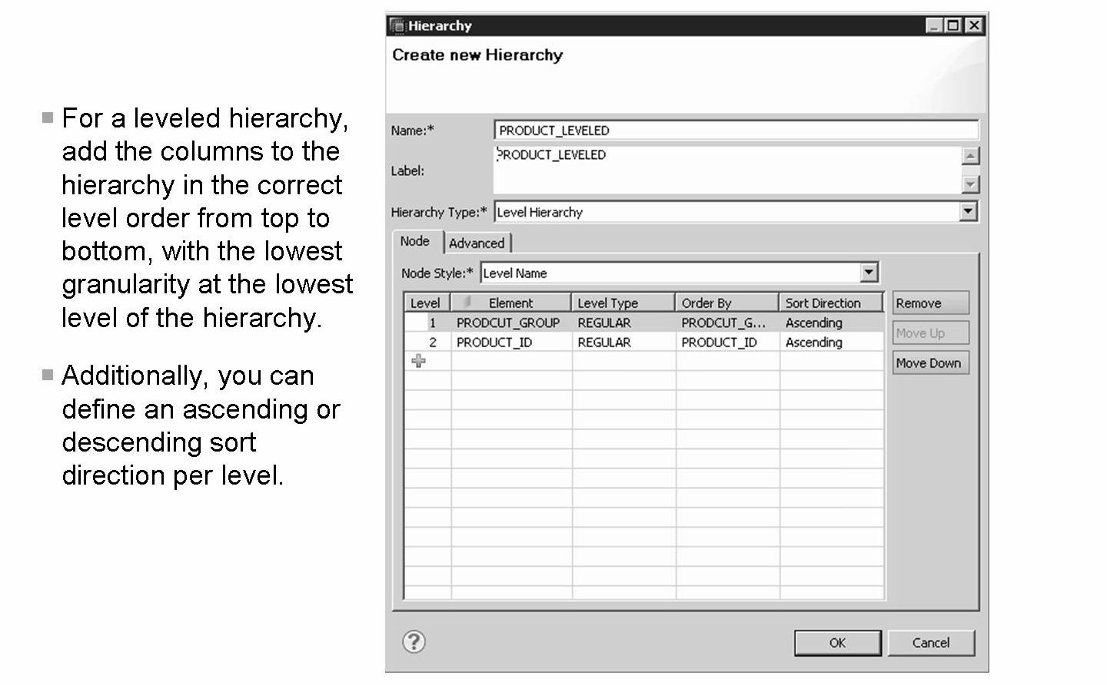
Creating Leveled Hierarchy

Slide 8
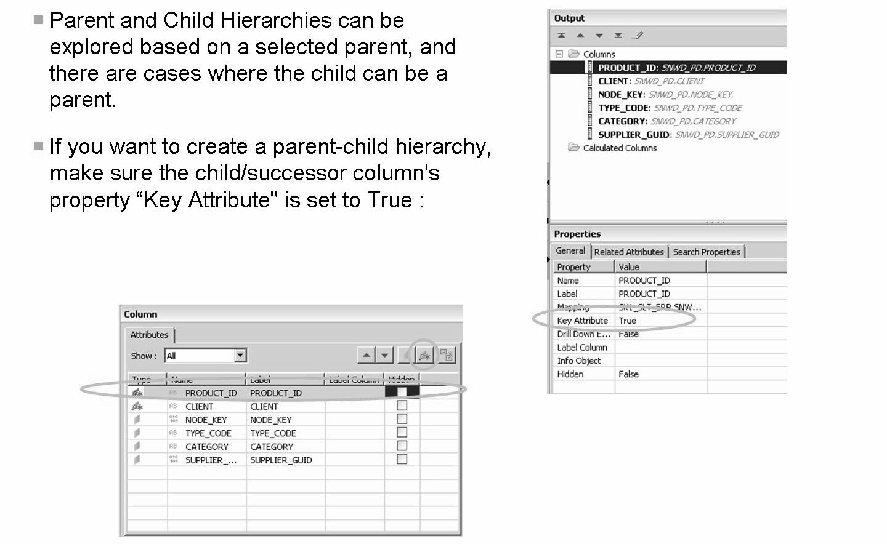
Creating Parent Child Hierarchies

Slide 9
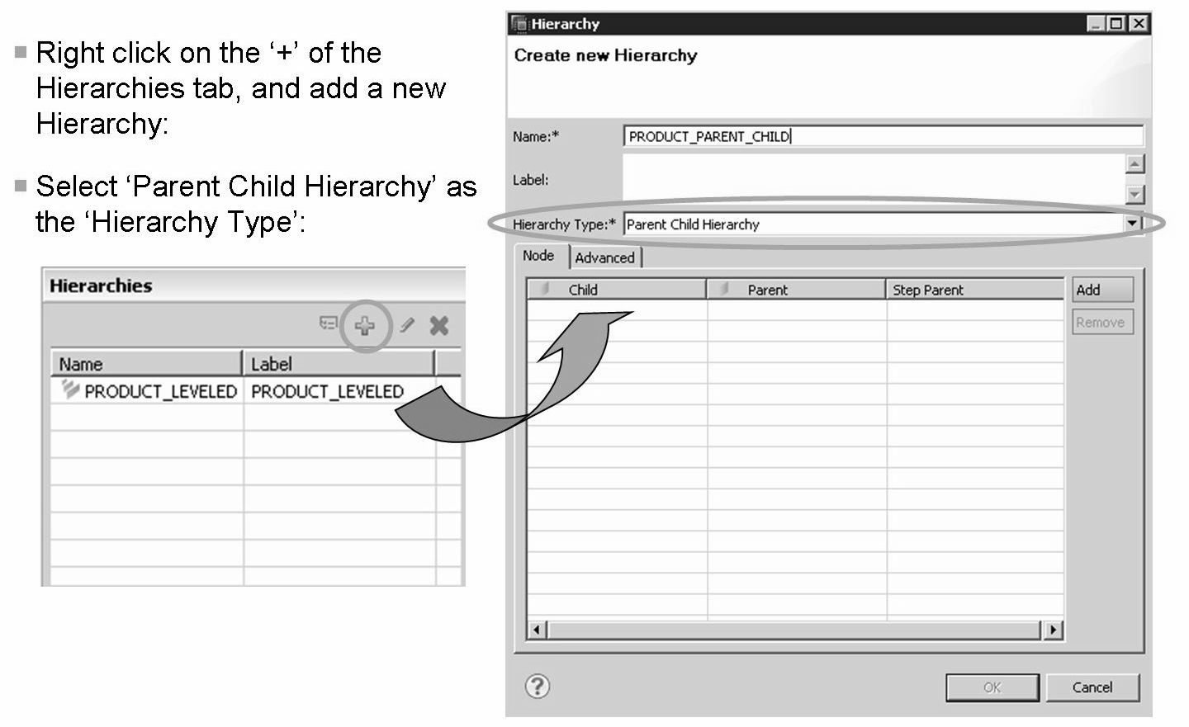
Creating Parent Child Hierarchies

Slide 10
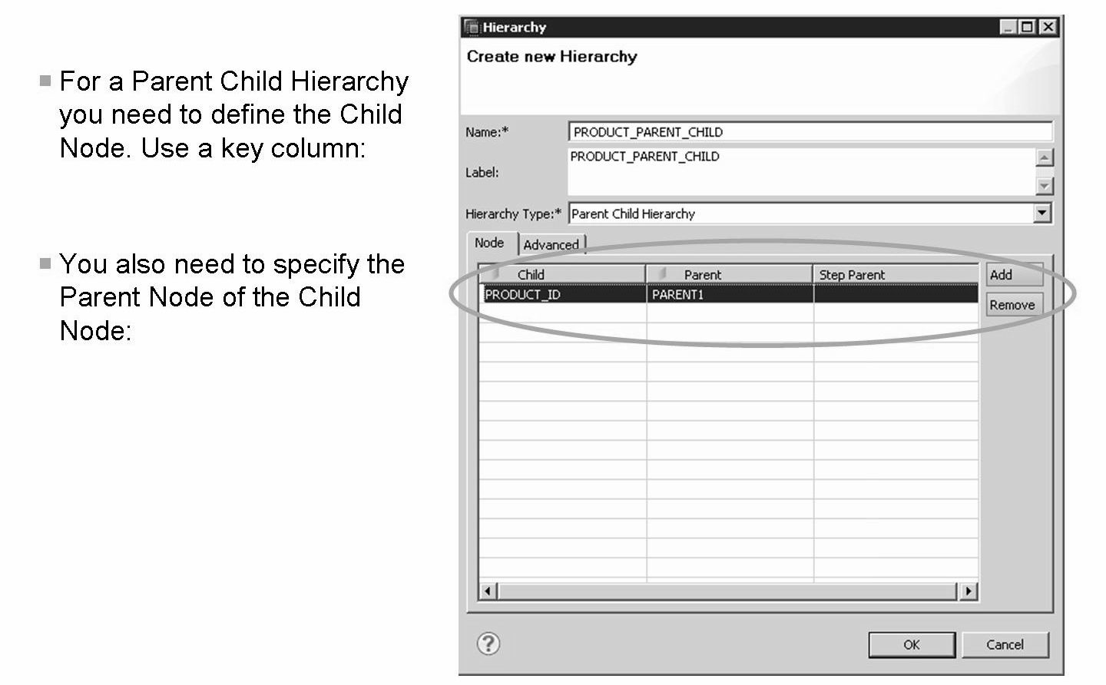
Creating Parent Child Hierarchies

Slide 11
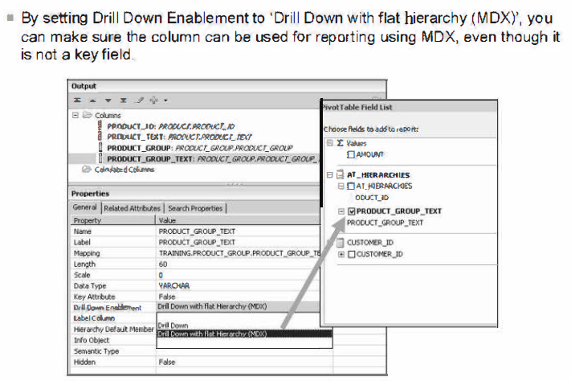

Slide 12
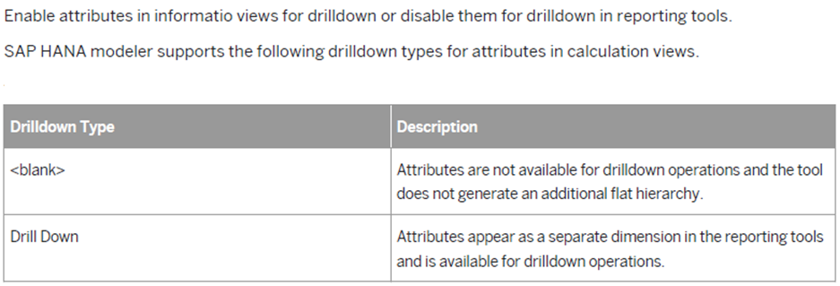
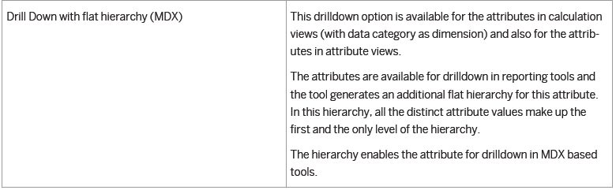
Supported Drilldown Types for Attributes

Slide 13
Reporting on an Analytic View with a hierarchy in MS Excel using MDX

Slide 14
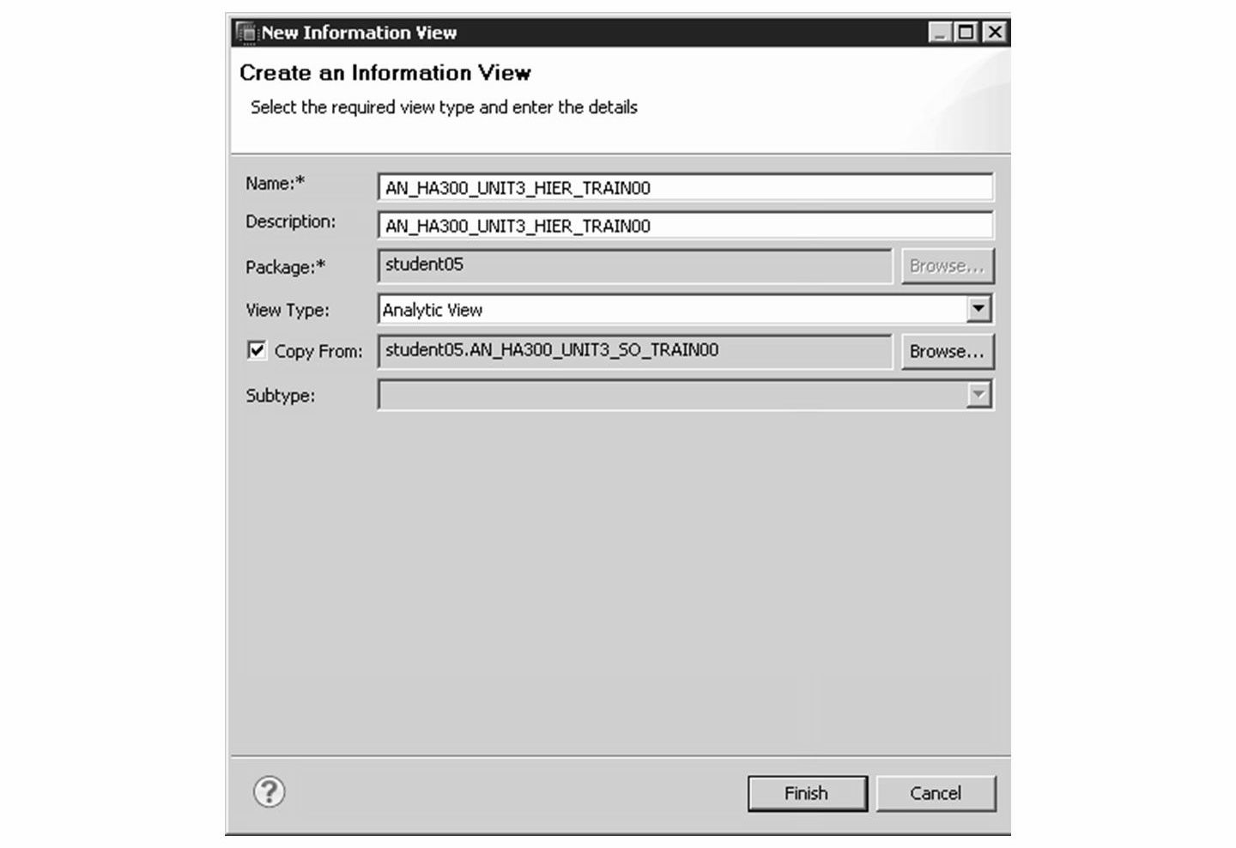
Create an analytic view

Slide 15
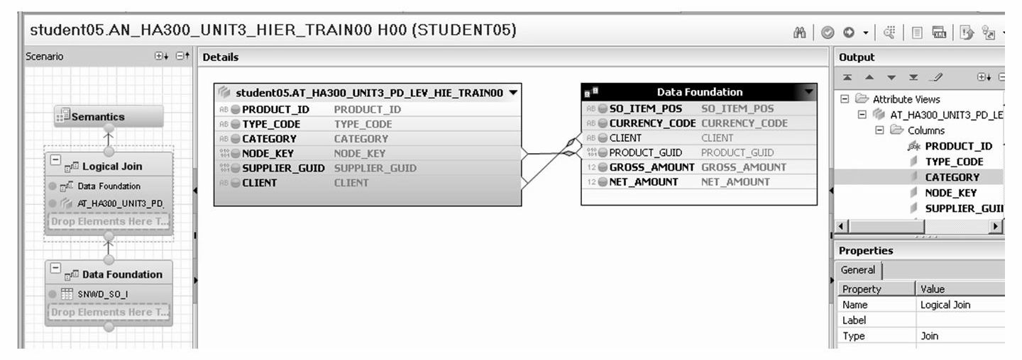
Define Logical Join
Save and Activate the Analytic View

Slide 16
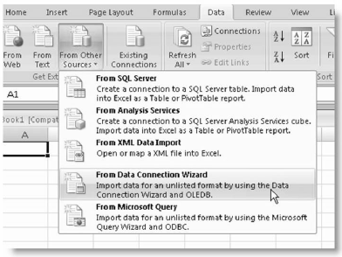
MS Excel Data Connection Wizard
Start MS Excel by going to Start → All Programs→ Microsoft Office → Microsoft Excel 2010
In the Data Ribbon, select From Other Sources → From Data Connection Wizard

Slide 17
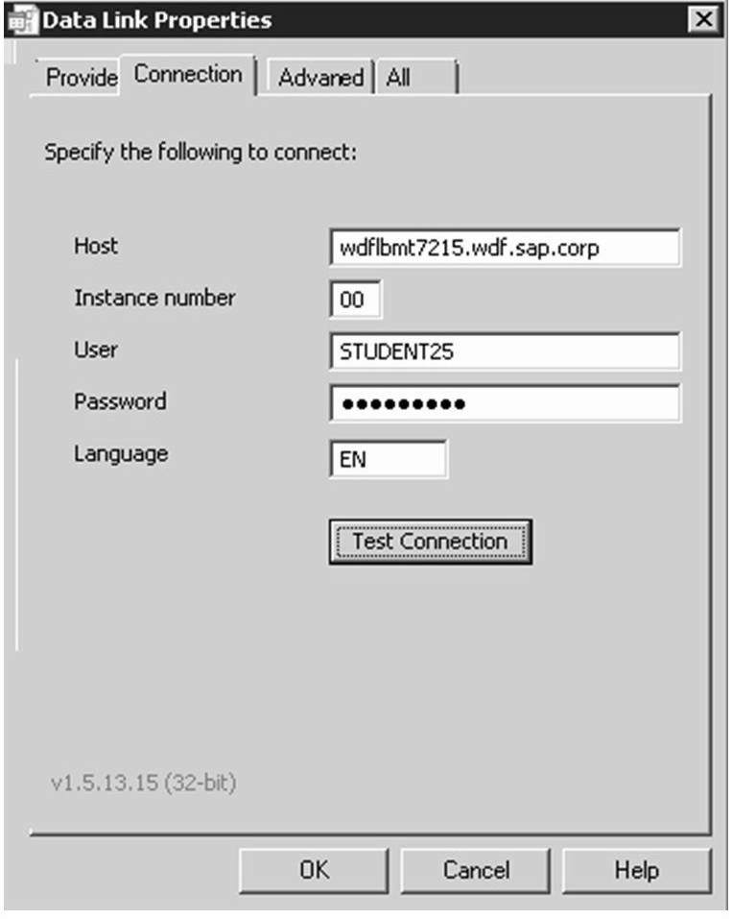
SAP HANA MDX Driver
On the next screen choose Other/Advanced, then select SAP HANA MDX Provider. Click Next and add the HANA server and credentials. Use your own Username and Password.

Slide 18
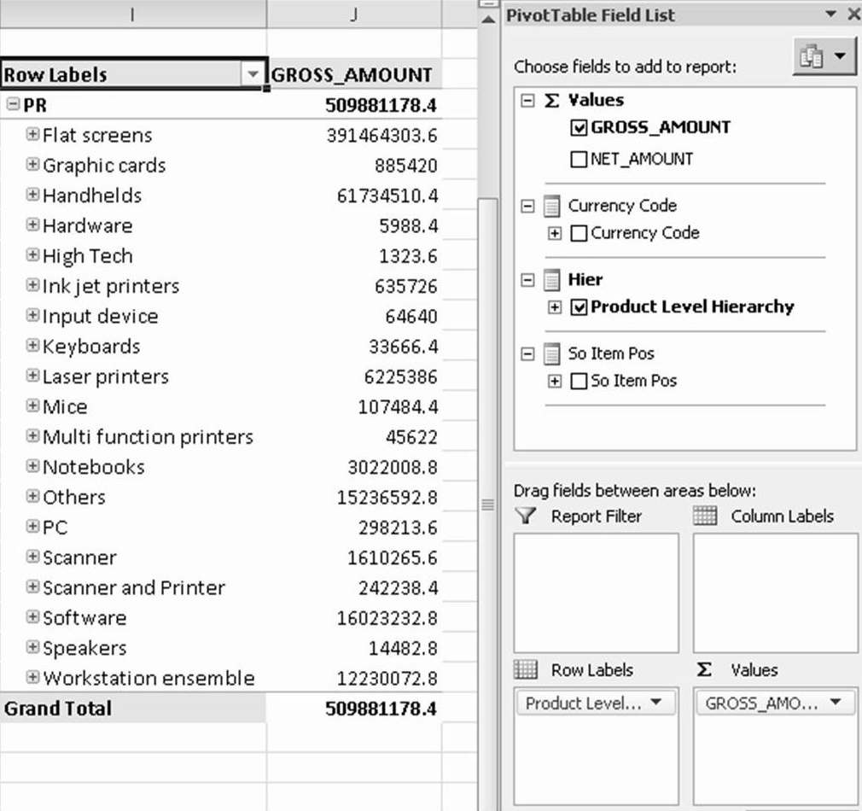
On the next screen change the package (database) to your own package and choose the Analytic view. Accept all the defaults and display the level hierarchy that you created.
Select the Product Level Hierarchy in the rows of the pivot table and add the measure.
Navigate in the hierarchy.

Slide 19
THANK YOU

